Slide 2

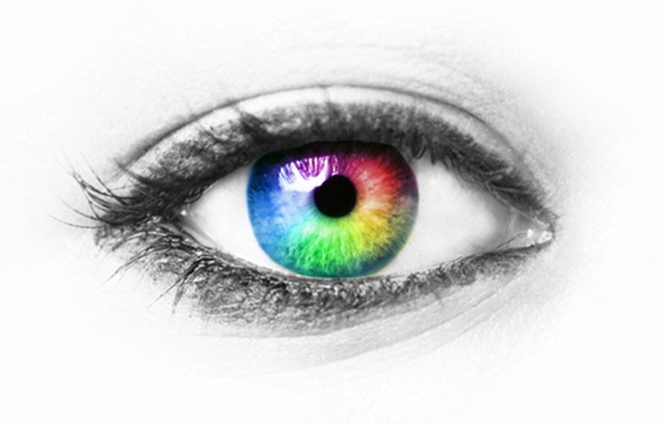
HUMAN EYE AND
THE COLOURFUL WORLD

Slide 3


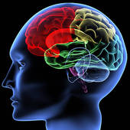


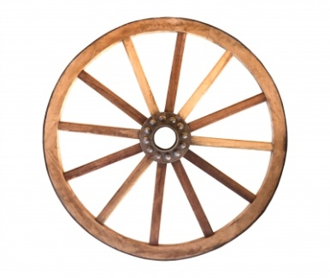

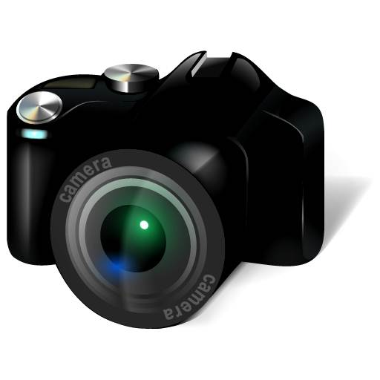
Human body and Inventions of Science are closely related
clenched fist
Leg
Brain
Human Eye
Hammer
wheel
Computer
Camera

Slide 4

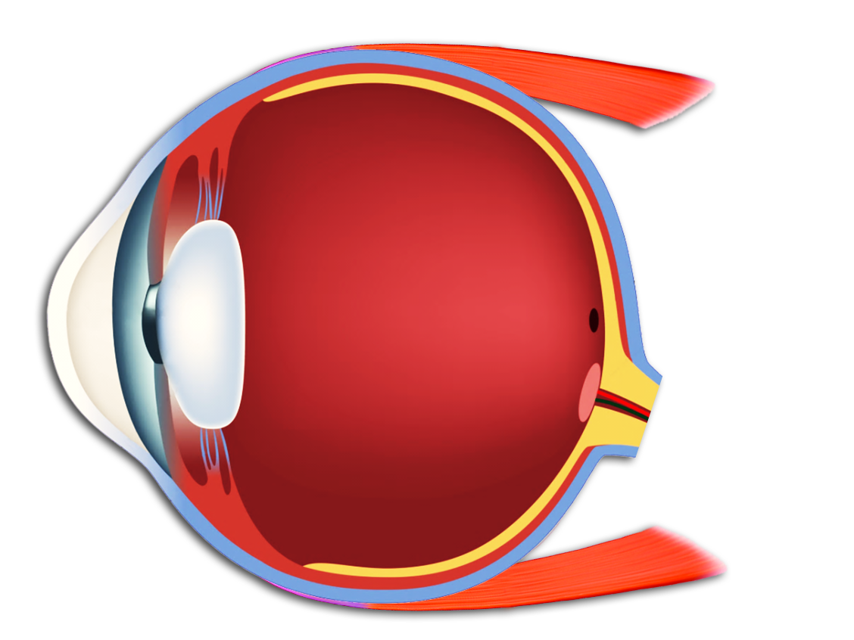
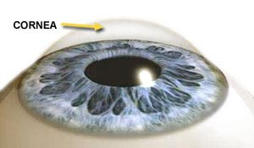
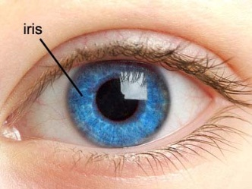
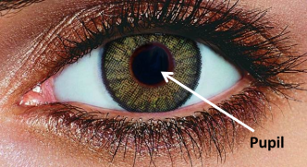
HUMAN EYE
Diameter of eye is about 2.4 cm.
Cornea
Maximum refraction of light takes place from cornea
Iris
Pupil
Cornea is a thin transparent membrane bulging outwards.
Pupil is opening of changing diameter at the centre of the iris
Behind the cornea there is a dark fleshy screen called the Iris

Slide 5
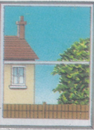
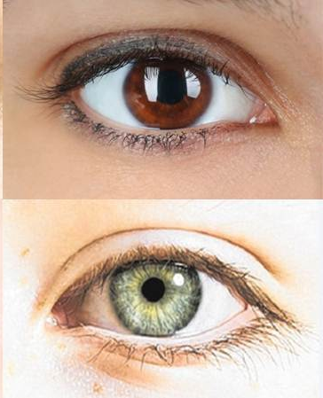
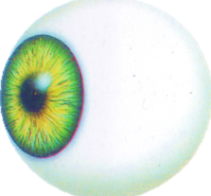
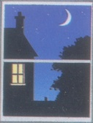
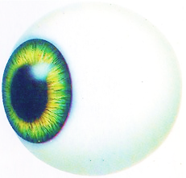
FUNCTION OF IRIS
Regulates the amount of light entering the eye
Imparts colour
to the eye
In bright light, pupil contracts
The tendency of the pupil to adjust the opening for light is called adaptation.
Different colour of eyes is because of different colour of iris
In dim light, pupil widens

Slide 6
HUMAN EYE
It is light sensitive screen made up of light sensitive cells. These cells get activated upon illumination.
The screen on which the image is formed in the eye called retina.
Cornea
Retina
Iris
Pupil
Eye lens
Eye-lens is transparent double convex lens.

Slide 7
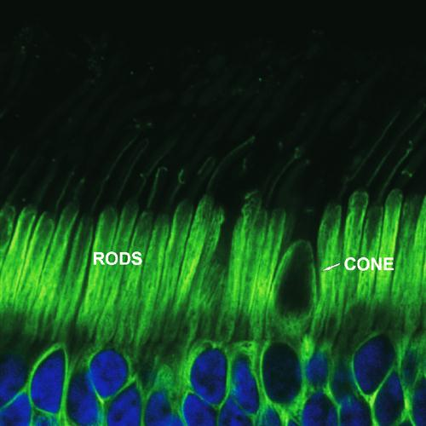
RETINA
Has two kinds of light sensitive cells
RODS
CONES
Rods are responsible for adjusting our eyes to different intensities of light
Cones are responsible for the perception of colour

Slide 8
HUMAN EYE
Blind spot
Aqueous Humour
At blind spot there are no light sensitive cells (no rods or cones) due to which no vision is possible at that spot.
Optic Nerve
Optic nerve carries electrical signals to the brain
Vitreous Humour
Ciliary
muscles
Ciliary muscles change thickness of eye-lens while focusing.
Muscles
Sclerotic coat
Choroid

Slide 9
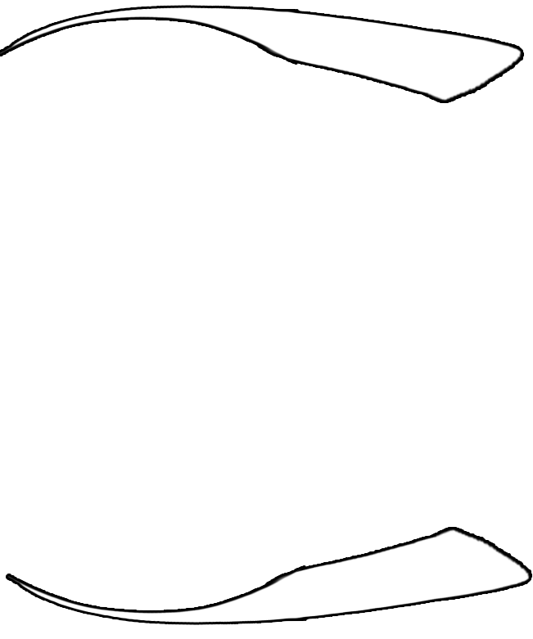
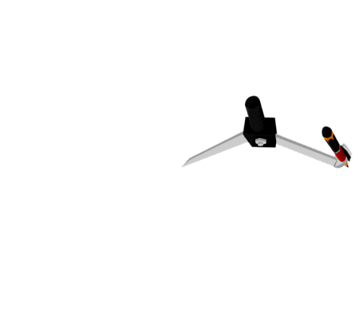
LETS LEARN TO DRAW HUMAN EYE
EYE LENS
MUSCLES
CORNEA
PUPIL
RETINA
BLIND SPOT
2
1
2
3
7
9
1
3
7
8
9
4
5
6
8
4
5
6
10
11
12
13
14
15
IRIS
10
11
12
13
14
15
OPTIC NERVE
CILIARY
MUSCLES

Slide 10
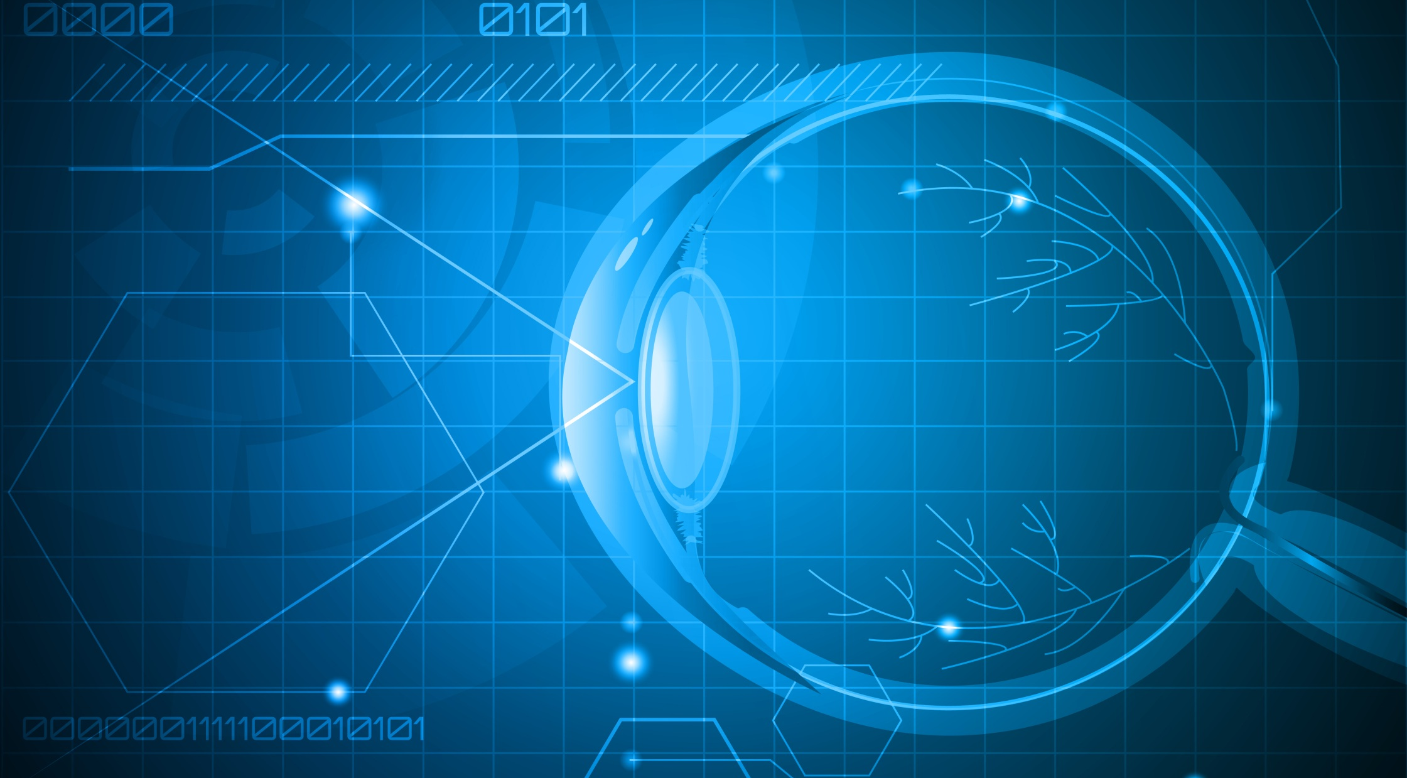
Match the function to its respective part of the human eye
PART
FUNCTION
1. Pupil
a) Bulges outwards and hence causes maximum refraction of light
2. Optic nerve
b) Imparts colour to the human eye.
Controls the amount of light that enters the Eye.
3. Cornea
c) Regulates amount of light entering the eye
4. Cone cells
d) Converge the rays of light so that the image is formed on the retina within the eye. It forms a real and inverted image.
5. Iris
e) Conveys the degree of brightness to the brain.
6. Eye lens
f) Conveys the colours of image to the brain.
7. Rod cells
g) Carries information of retinal image to the brain.

Slide 11


Power Of Accommodation
The capacity of the lens to change its focal length as per need is called its power of accommodation.
FAR AWAY OBJECTS
While seeing objects at large, infinite distances, the lens of the eye becomes flat and its focal length increases.

Slide 12
Power Of Accommodation
NEARBY OBJECTS
The ability of the lens of adjusting focal length is known as power of accommodation.
While seeing nearby objects the lens becomes more rounded and its focal length decreases.

Slide 13
The minimum distance of an object from a normal eye, at which it is clearly visible without stress on the eye, is called as minimum distance of distinct vision.
The ability of the lens of adjusting focal length is known as power of accommodation.
For a normal human eye, at the near point is at 25 cm.

Slide 14
Thank You

